Slide 1
Positive future

Slide 2
People act
Individuals, families, communities, universities, businesses, governments decide to act, together, against catastrophic climate change.
www.ntu.ac.uk

Slide 3
Carbon Literacy
Companies, schools, universities and public institutions commit to Carbon Literacy training for all.
Sustainability is embedded into curriculums.
www.ntu.ac.uk

Slide 4
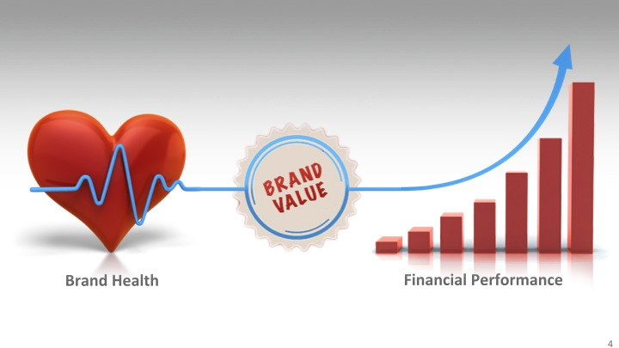
Innovation
As business leaders call on their workforce to help them become sustainable, every element of their ethos and process is examined. The result is a 40% uplift in innovation. Brand value increases as consumers enjoy the benefits. Share price increases.
www.ntu.ac.uk

Slide 5
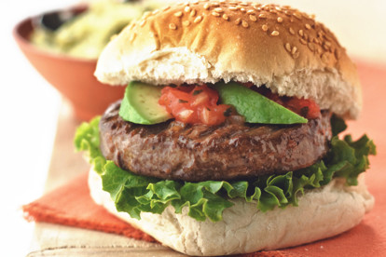
Dietary overhaul
Historic reduction in meat consumption. Vegetarian and vegan diets widely adopted. Meat alternatives become the major, not the minor.
Meat is seen as a premium product.
www.ntu.ac.uk

Slide 6
Telepresence
Increasingly, workers are able to reduce their carbon footprint by working remotely. Disparate teams communicate electronically.
Academic conferences are held online, so aviation emissions decrease.
Companies soon realise the cost savings.
www.ntu.ac.uk

Slide 7
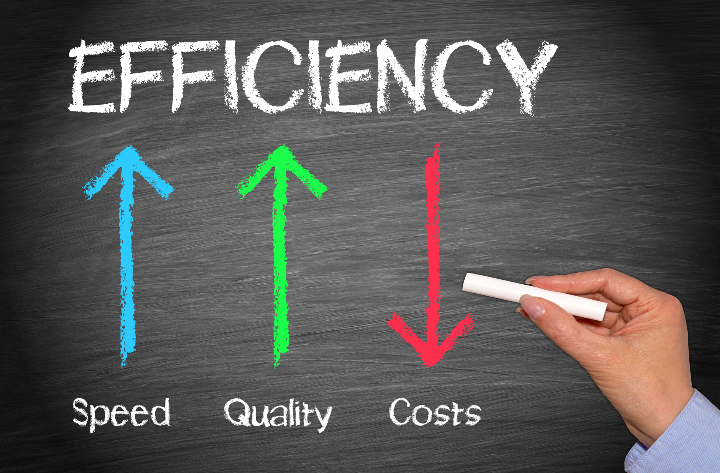
Efficiencies
Old, inefficient equipment and practices are replaced through managed upgrade programmes. Payback time on capital expenditure shrinks. Companies reinvest cost savings and simultaneously realise a net reduction in carbon.
www.ntu.ac.uk

Slide 8
Political cooperation
All nations sign or re-enter the Paris Climate Agreement. There is an international commitment to limit global warming to within 1.5-2 degrees Celsius of pre-industrial levels.
www.ntu.ac.uk

Slide 9
Universities lead by example
Universities lead by example by committing to ambitious carbon reduction targets and detailed reporting on emissions.
www.ntu.ac.uk

Slide 10
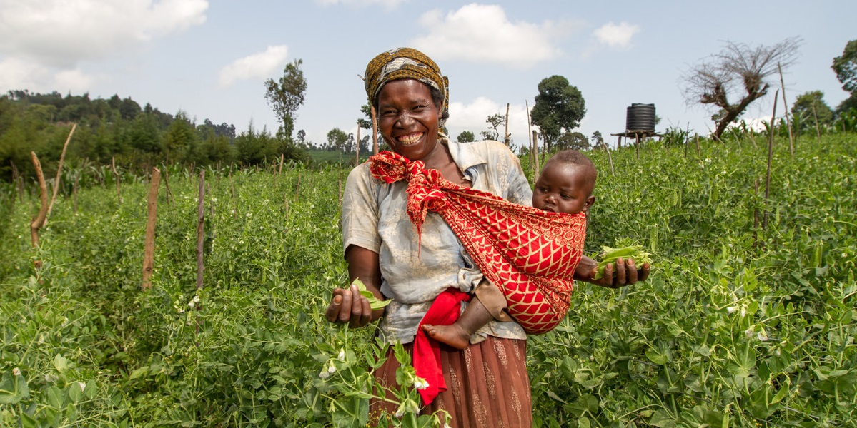
Women become more educated
Equity of education and opportunity for women sees millions of women become smallholders with improved family planning. Productivity increases while disease and poverty is reduced.
Land is used better and results in a net carbon saving of millions of tonnes.
www.ntu.ac.uk

Slide 11
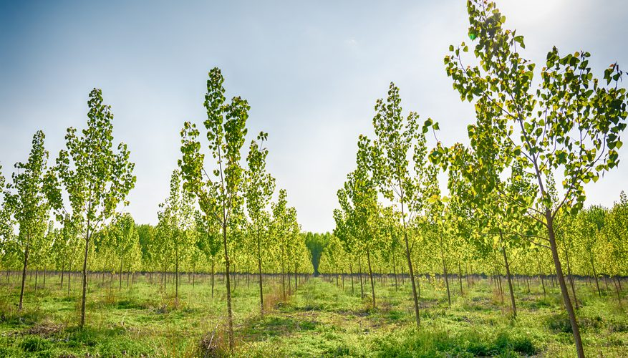
Afforestation
Millions of trees are planted all over the world. These forests will grow and remove huge quantities of carbon dioxide from the atmosphere.
Deforestation of the Amazon is severely restricted.
www.ntu.ac.uk

Slide 12
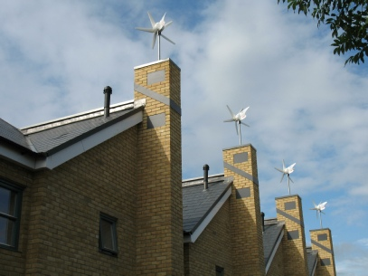
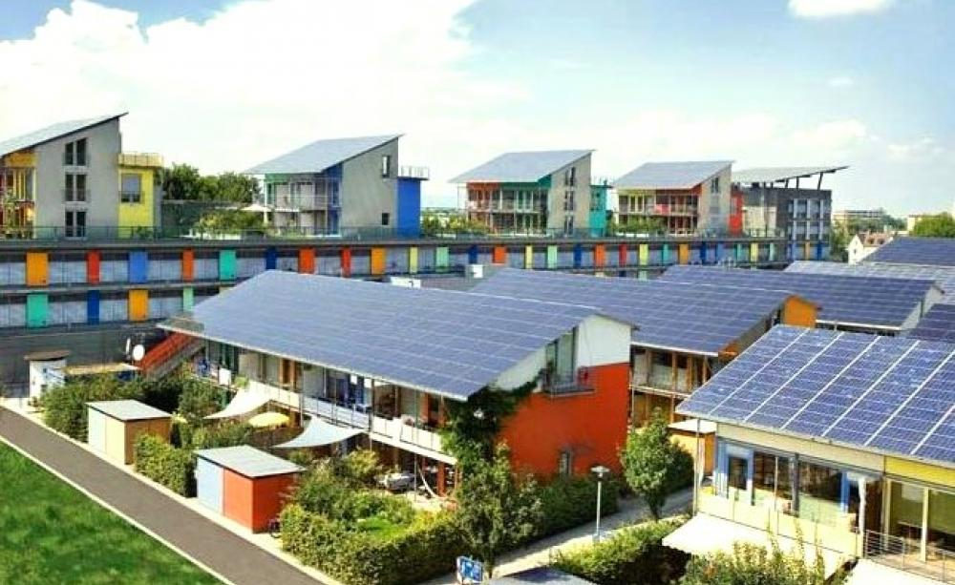
Micro-generation of renewables
Governments incentivise universities, businesses and citizens to run micro-generation projects for renewable energy.
Households and universities generate more electricity than they need and export the excess at a profit.
www.ntu.ac.uk

Slide 13
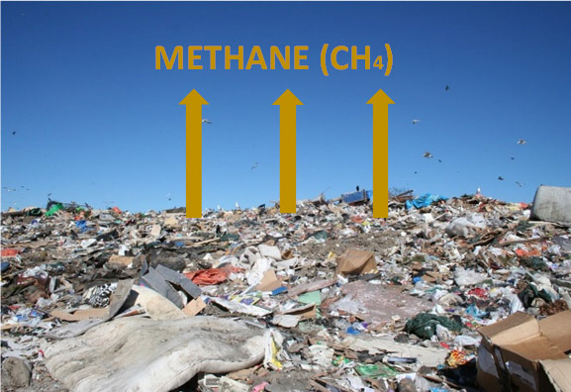
Recycling reduces methane from landfills
Wealthy countries approve strict laws requiring their businesses, universities and citizens to recycle their waste. Innovative systems for recycling of organic and inorganic matter are embedded into the supply chain in poorer countries.
Vast quantities of heat-trapping methane is prevented in landfill.
www.ntu.ac.uk

Slide 14
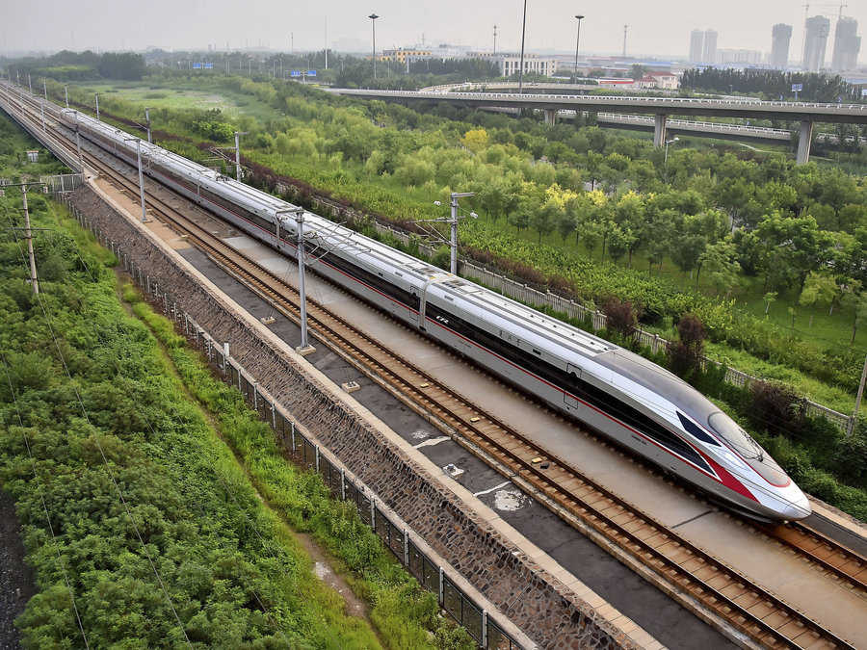
High-speed rail viable alternative to flying
Countries invest in high-speed rail networks.
Journeys by train are significantly cheaper than the equivalent journey by air.
www.ntu.ac.uk

Slide 15
Water efficiencies
Education combines with innovation to manage water much more effectively in homes and industry.
Water and carbon are saved on unprecedented scales.
www.ntu.ac.uk

Slide 16
Fashion overhaul
Alternatives to cotton and synthetic materials save water, and carbon. New technologies allow the user to alter the colour and design of garments. Fabrics last longer.
Disposable fashion is rejected.
www.ntu.ac.uk

Slide 17
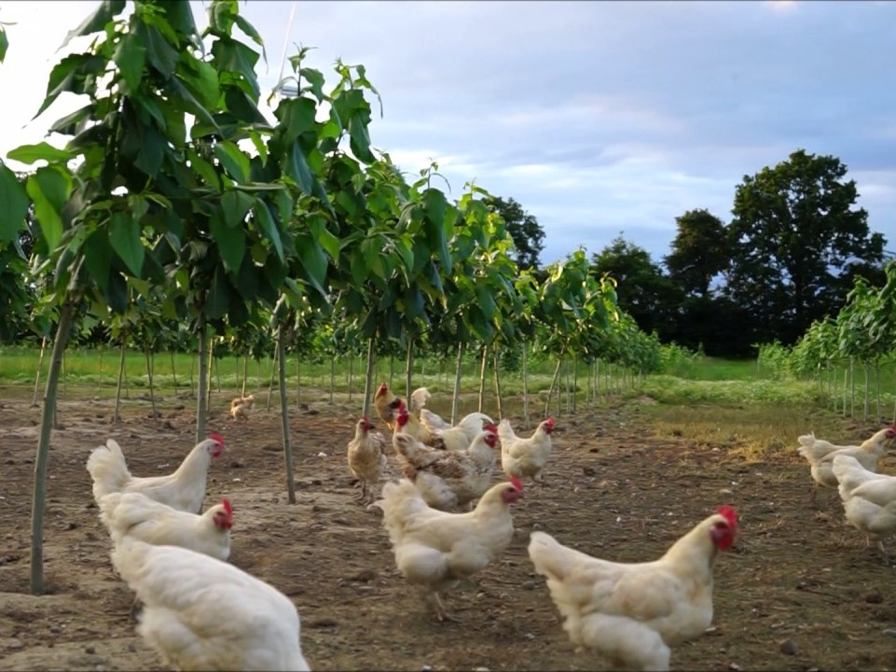
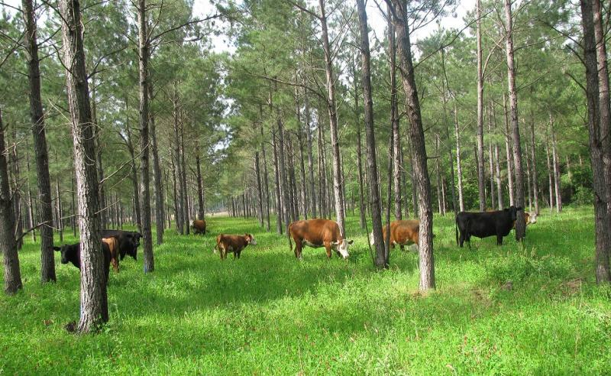
Agricultural land use improves
Education and practise of silvopasture increases.
Efficient use of land creates larger yields and cost savings.
Knowledge is passed on.
www.ntu.ac.uk

Slide 18
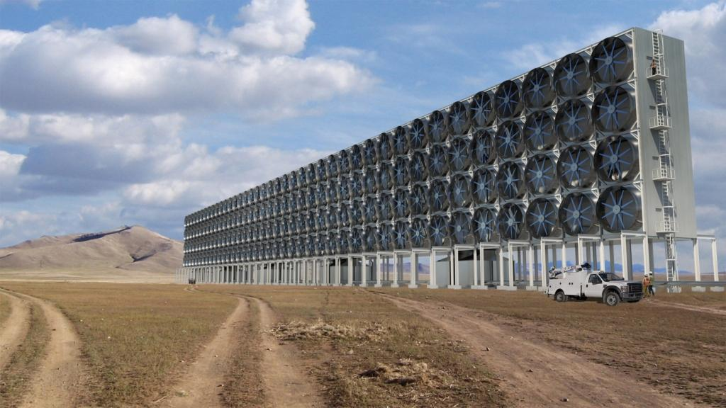
Carbon capture
Universities help to develop technologies to assist in localised reductions of atmospheric carbon. They are paid for by the most polluting industries.
Jobs are created as companies innovate.
www.ntu.ac.uk

Slide 19
Behaviours embedded
Carbon literacy training is a standard part of every education system. Lifestyle habits and behaviours are routinely efficient in terms of energy and water use, recycling and waste disposal. People no longer think about their decisions and look back with disbelief at how we used to live.
www.ntu.ac.uk

Slide 20
Shifting of investments
Universities, banks and pension funds move their financial investments away from fossil fuels and reinvest in sustainable, ethical alternatives.
www.ntu.ac.uk

Slide 21
Conservation of carbon sinks
Greenspaces within university estates, public parks and household gardens is conserved to better function as carbon sinks.
www.ntu.ac.uk

Slide 22
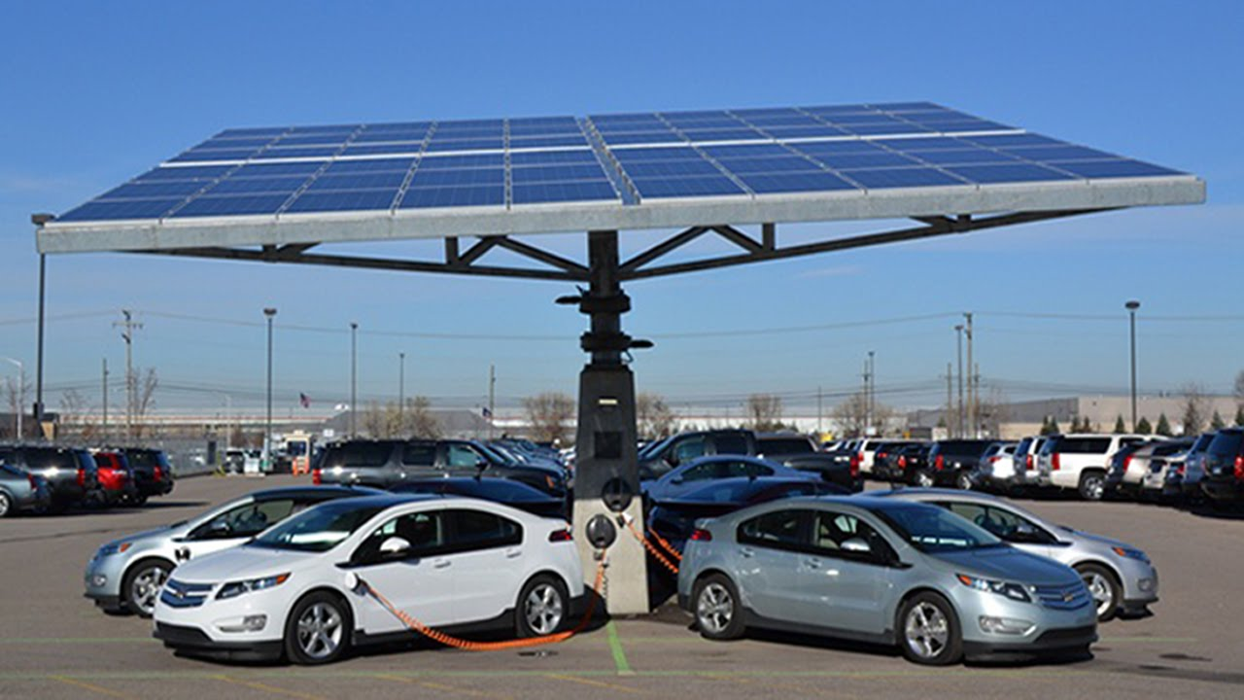
Electric cars are ubiquitous
Infrastructure and ownership of electric vehicles are commonplace across Europe, America and large parts of Asia. The batteries of electric vehicles provide a distributed storage network for balancing renewable energy supply and demand.
www.ntu.ac.uk

Slide 23
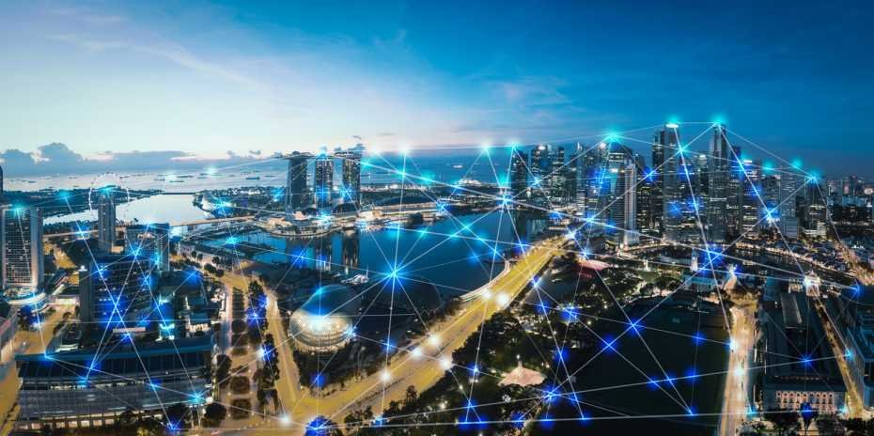
Smart grids, building management
Energy is managed holistically and intelligent technology integrates with big-data to distribute resources efficiently.
Financial and carbon savings are realised immediately.
www.ntu.ac.uk

Slide 24
Standards of living improve
Through better management of resources, countries enjoy economic prosperity on all continents
People live more comfortably.
www.ntu.ac.uk

Slide 25
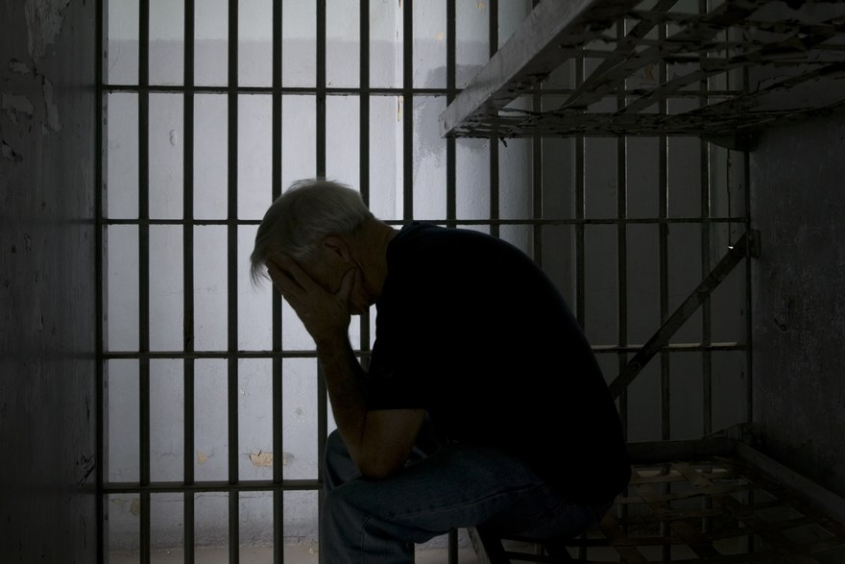
Accountability
Seven politicians and a number of senior business leaders from six states are extradited and found guilty of conspiracy to commit ecocide.
Jail sentences range from 4-22 years.
www.ntu.ac.uk

Slide 26
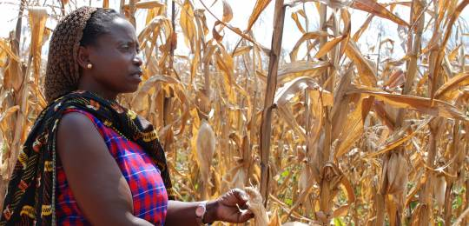
Nitrogen fixing for wheat crops
A genetic solution is discovered to eliminate the need to artificially fertilise wheat crops. Millions of tonnes of carbon are saved as fertilizer production is vastly reduced.
The inventor wins a Nobel prize.
www.ntu.ac.uk

Slide 27
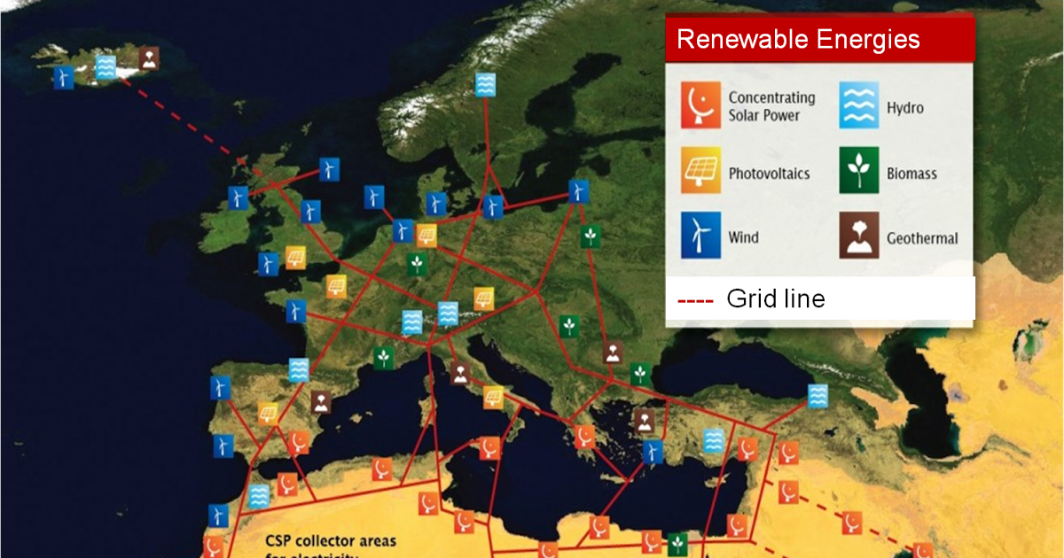
European renewables super-grid
Continents pool their diverse energy resources into a renewables super-grid, creating energy independence and a long-term commitment to carbon reduction.
www.ntu.ac.uk

Slide 28
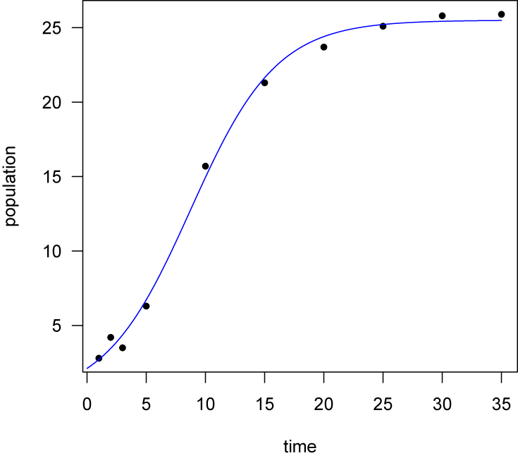
Population increase stabilises
Despite extended life-expectancy, global population growth plateaus at 9.2 billion.
www.ntu.ac.uk

Slide 29
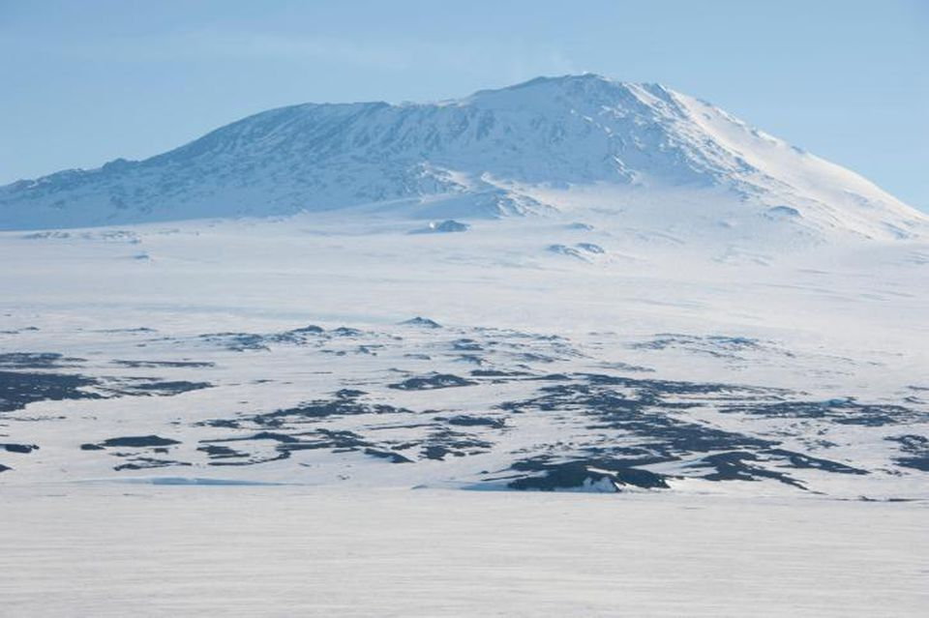
Carbon dioxide concentrations reduce
Humans succeed in their efforts to reduce carbon emissions.
Carbon dioxide concentrations reduce to 350 ppm.
Global warming is kept well below 2 degrees Celsius.
www.ntu.ac.uk

